Slide 1
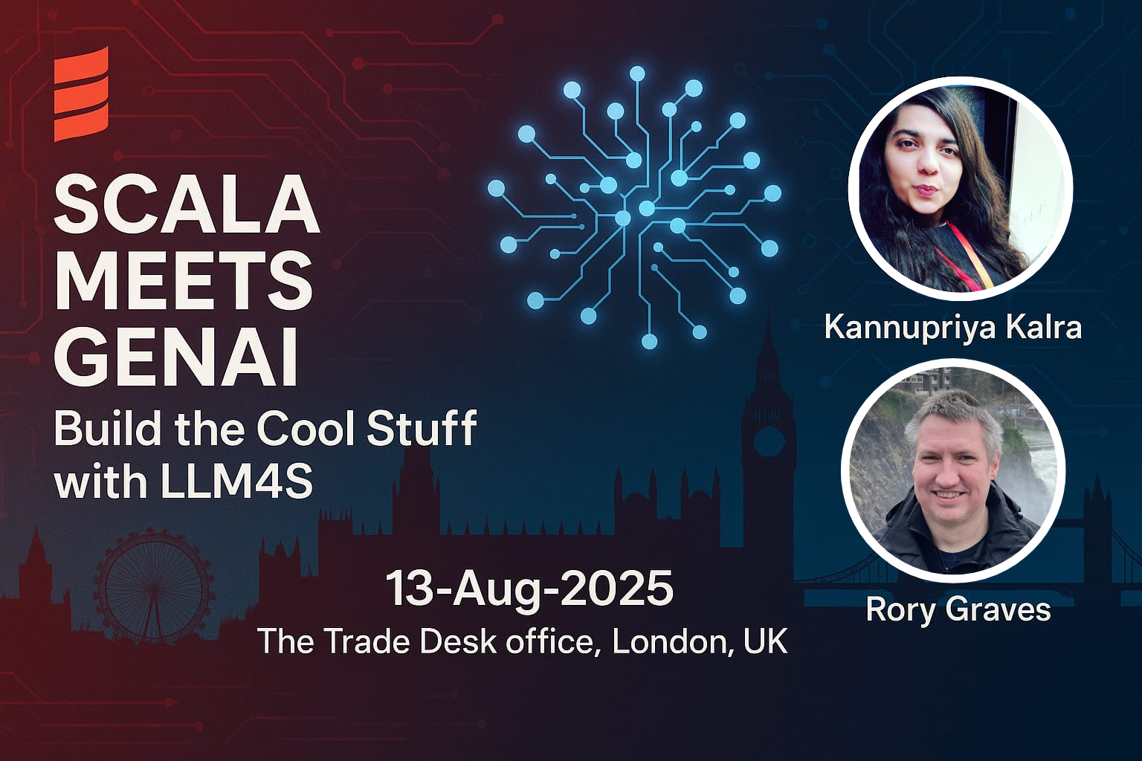

Slide 2



Let's Play Szork!
100% Scala-Powered AI Adventure

Slide 3


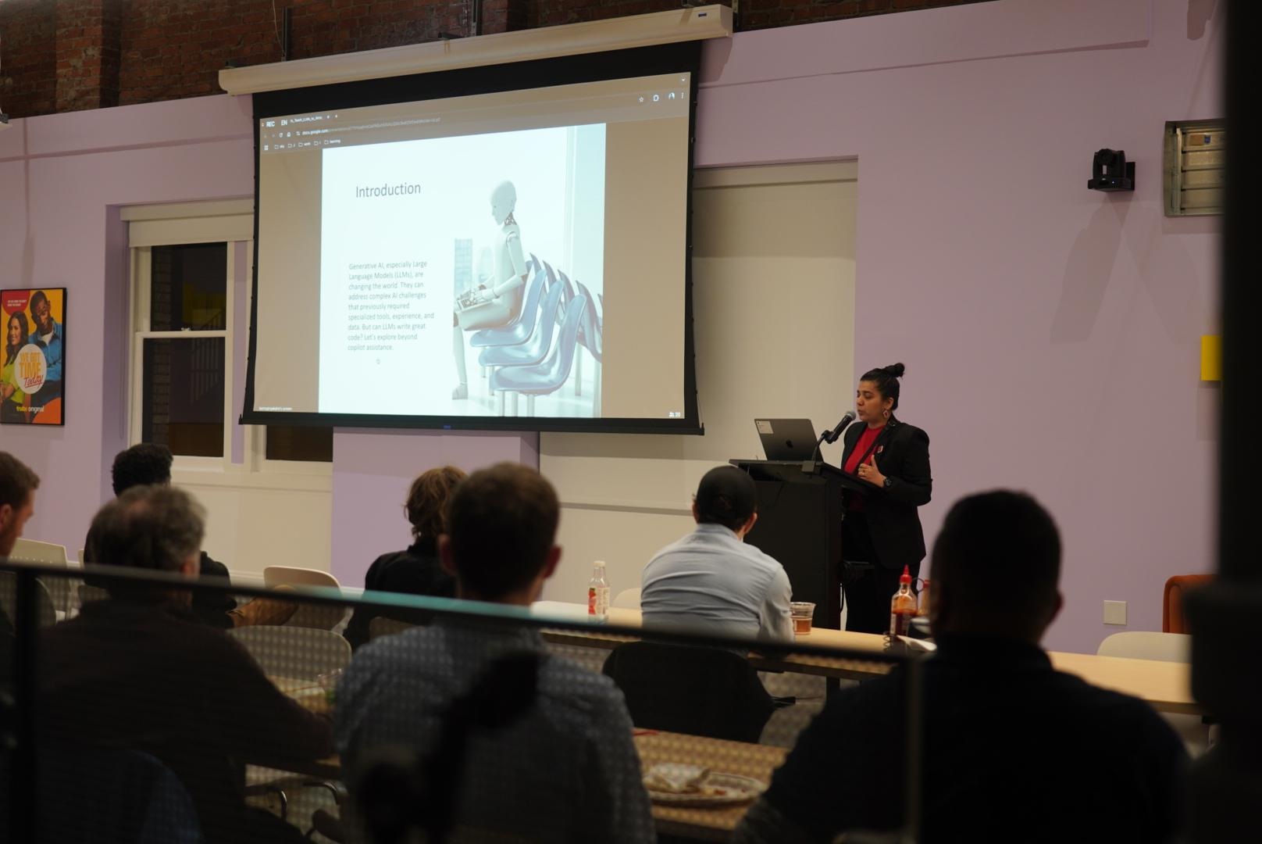
The Magic Behind the Scenes

Slide 4

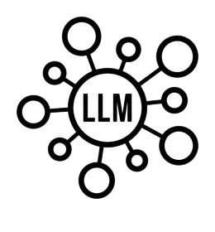




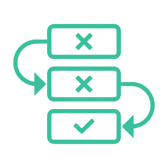
Szork's Inner World 🪄
→ LLM as DM : Narrative generation & game state tracking
→ Speech-to-Text : Voice commands
→ Text-to-Speech : Spoken responses
→ Image Generation : Dynamic scene illustrations
→ Tool Calling : Inventory, combat, puzzles
→ Agentic Workflows : DM manages state and game flow

Slide 5



Who We Are 🤔
Rory Graves
A Scala advocate and software engineer with 30+ years of experience across diverse systems. He has contributed to Scala compiler optimizations and supports AI/ML research while mentoring developers. Beyond tech, he is a martial artist, windmill tour guide, and public speaking mentor. LinkedIn: https://www.linkedin.com/in/roryjgraves/
Kannupriya Kalra
Backend engineer and community leader specializing in type-safe, functional AI development. Creator of LLM4S, a Scala-first toolkit inspired by LangChain and Pydantic, she brings structure and reliability to generative AI. With 10+ years’ experience, she’s led engineering at Sky, mentored Google Summer of Code contributors, and spoken at conferences worldwide, shaping how typed languages integrate with modern AI. LinkedIn: https://www.linkedin.com/in/kannupriyakalra/

Slide 6
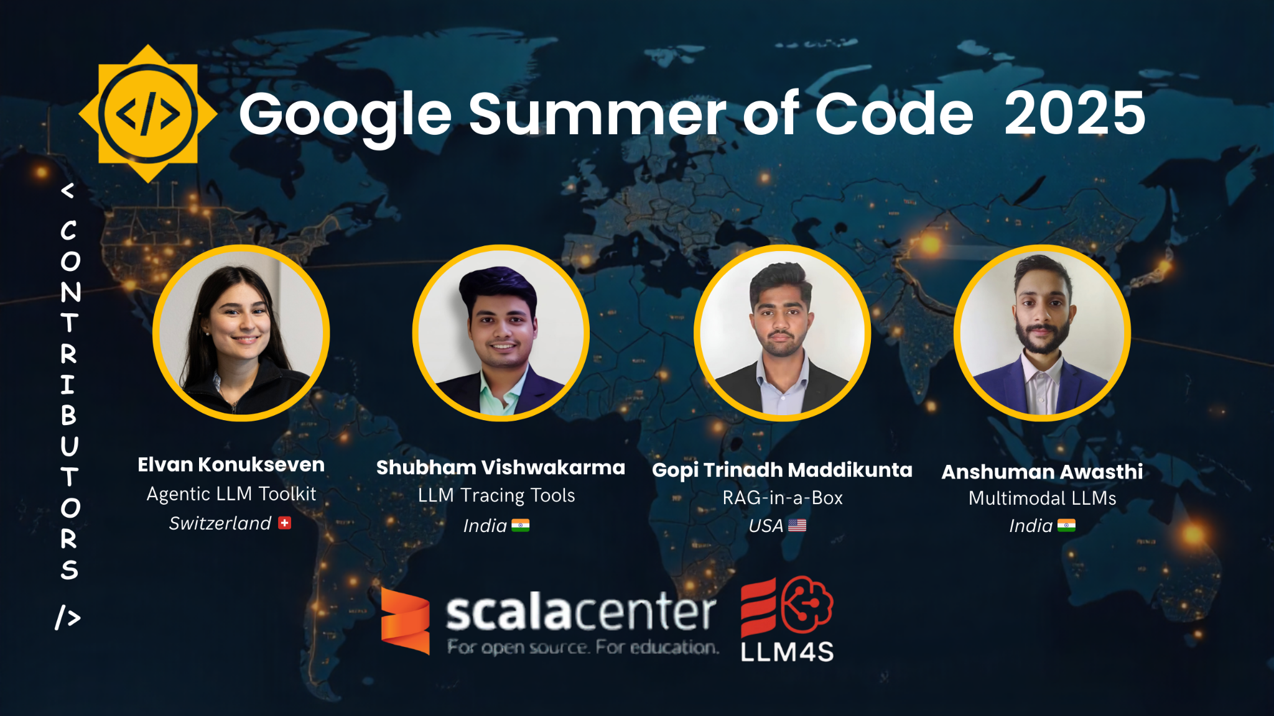

Slide 7

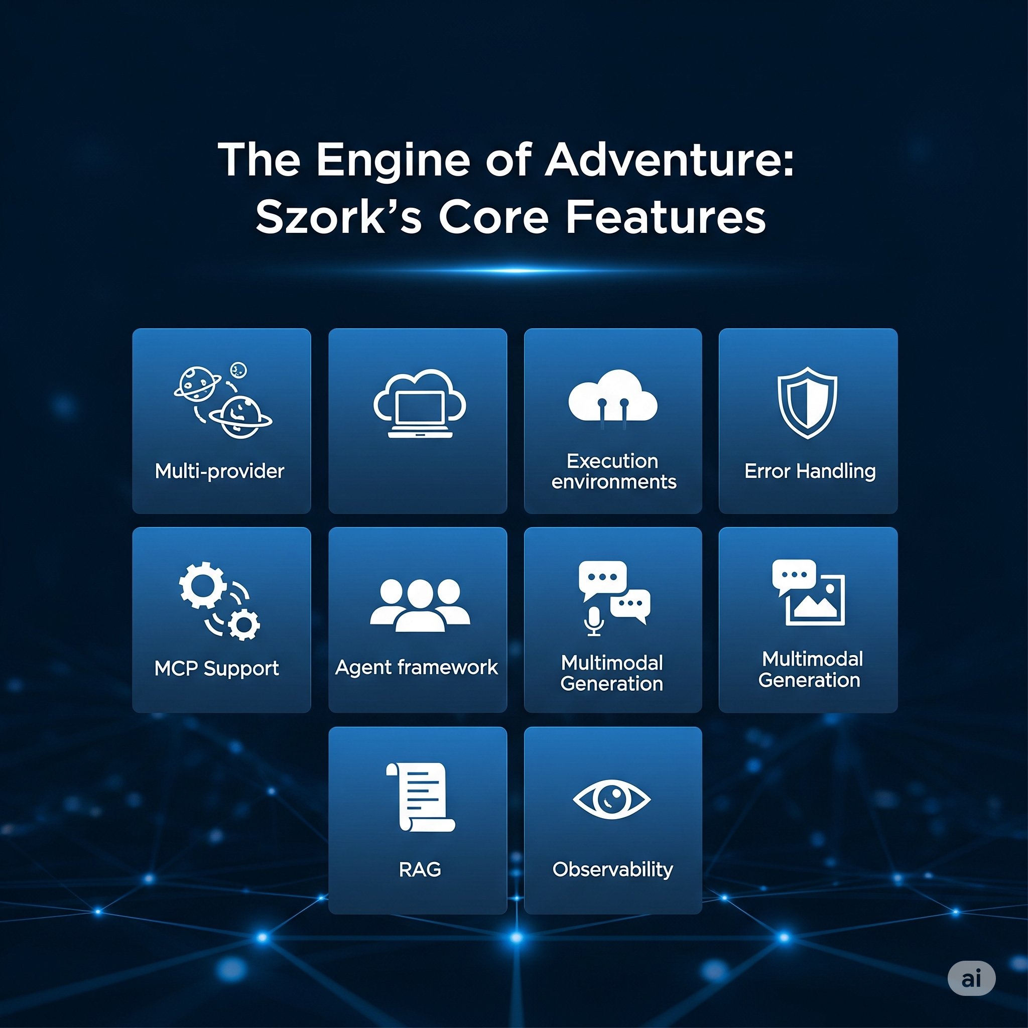

Production Features
LLM4S Production Features
- Multi-provider
- Execution environments
- Error Handling - MCP Support
- Agent framework
- Multimodal Generation
- RAG - Observability
Cross Scala Support

Slide 8

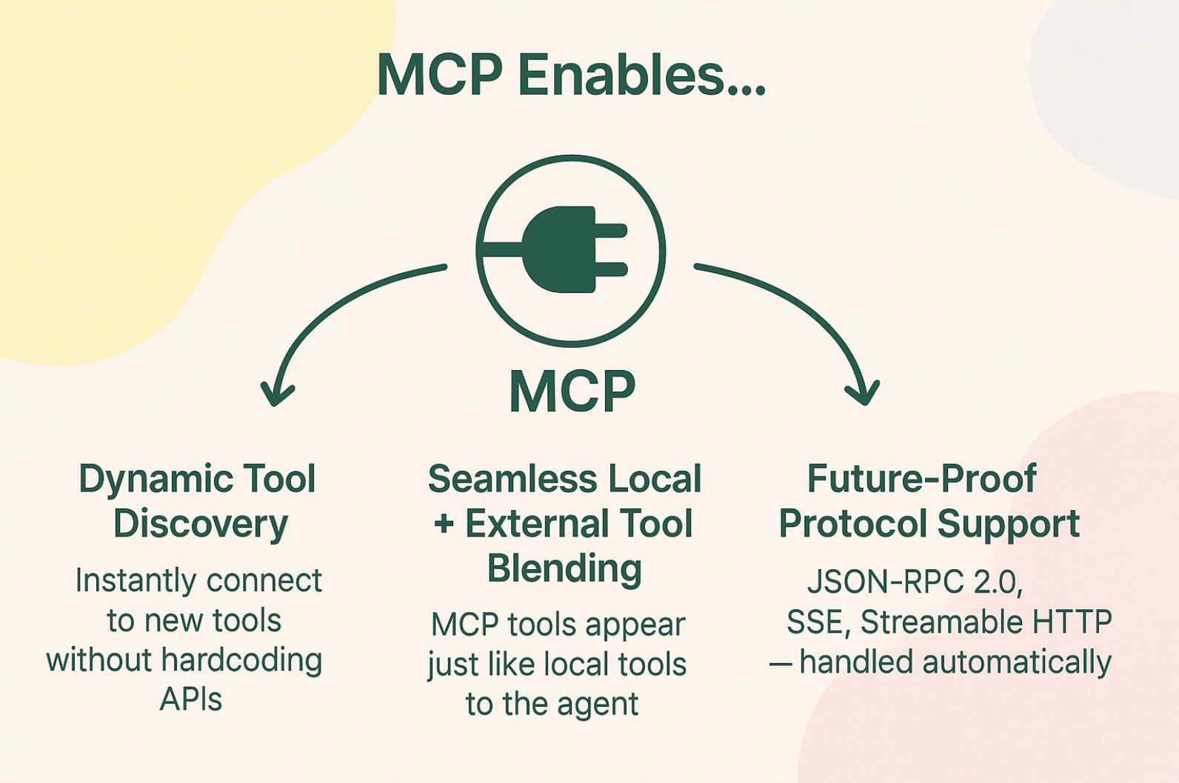
Model Context Protocol
MCP extends LLM4S agent's possible toolset and allows developers to seamlessly connect to any MCP server.
Plug into any tool, effortlessly

Slide 9
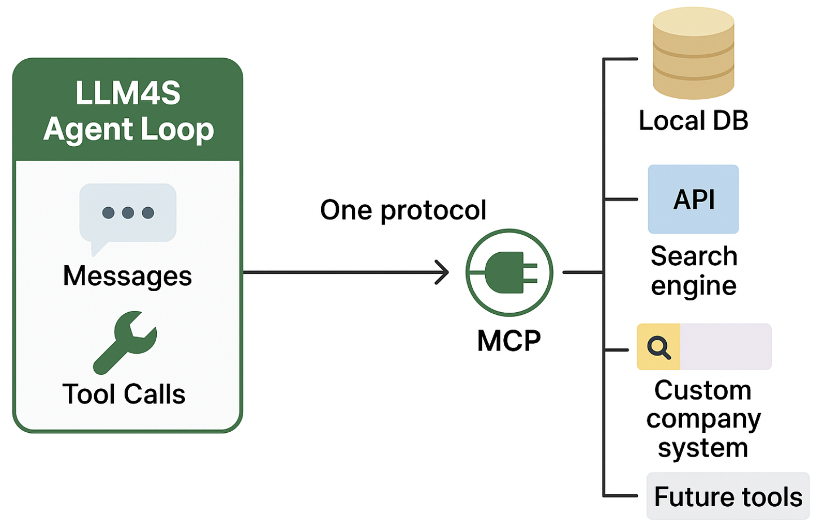
One Protocol. Every Tool. Powered by LLM4S.
One Protocol, Any Tool – MCP unifies every tool source — from local DBs to cloud APIs to future systems — into a single interface your agent already understands.
Agent Loop Ready – The LLM4S agent loop handles messages and tool calls natively; MCP just drops new capabilities straight into that flow, no code changes.
Scalable by Design – Add, swap, or upgrade tools without touching the core → growth without friction.

Slide 10


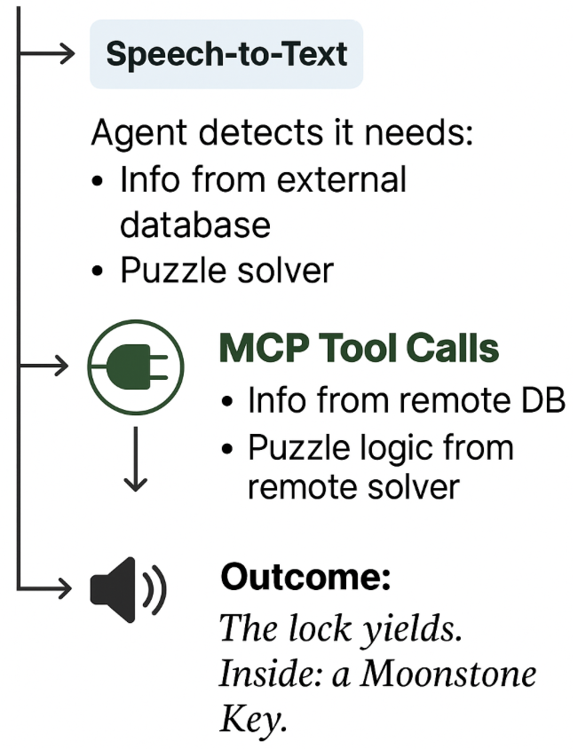
MCP in Action: Powering Szork’s World
In Szork, MCP lets the Dungeon Master agent reach out to any external tool mid-game, enriching the story, solving puzzles, and reacting to the player in real time.
Why this matters for Szork: Dynamic expansion —> Add new puzzles, items, or NPC behaviors from remote services without updating the game code.
Unified tool handling —> Local and external tools look identical to the agent.
Fast iteration —> Try new features during development or live events without deployment delays.
Future-proof —> Swap or upgrade tools as MCP evolves, without rewriting integrations.

Slide 11

Retrieval-Augmented Generation
Beyond Games
RAG Architecture
Grounded by design: Retrieve → Generate ⇒ answers come with citations (receipts, not vibes).
Handle large sources - expands the context
Dynamically updatable: Update the index, not the model; smaller models + sharper context.
Latency as UX: Retrieval is part of the product—keep it snappy so interactions feel live.
Governance up front: Decide what’s eligible at ingest and enforce at retrieve; safe by design.
.

Slide 12
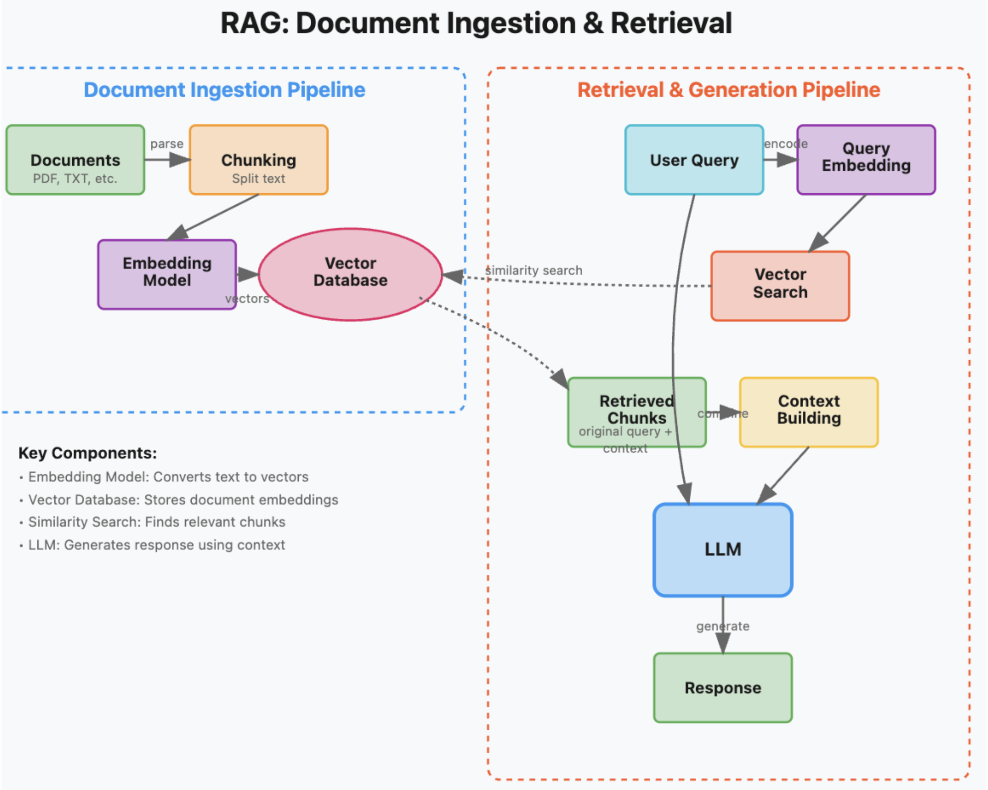

Slide 13
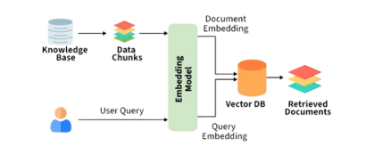
Built (now)
EmbedX plug-in embeddings → extract → chunk → embed → retrieve.
UniversalExtractor: .pdf/.txt/.csv/xlsx/.docx/URL.
Answers with receipts (citations on); no retrieval = no answer.
Config-driven model swap; FAISS baseline; structured logs.
Next (in flight)
PGVector: DB-backed retrieval + SQL filters + fast index.
Multimodal embeddings (text + image).
Tokenizer-aware chunking, hybrid search + light re-ranker.
Scoreboard: accuracy • coverage • cost • safety.

Slide 14

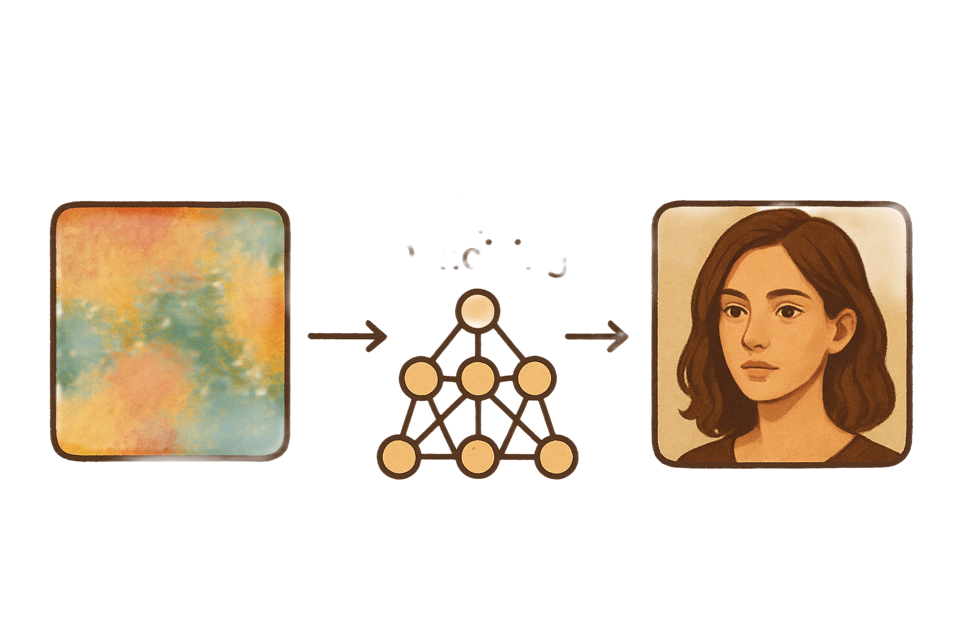
Multimodality: Image Generation and Processing
Create Images, Whenever you feel like it!
Stable Diffusion at work
Image Generation – Uses advanced AI models like GANs, VAEs, and diffusion models to create new images from scratch, often guided by inputs such as random noise, text descriptions, or reference images.

Slide 15





Supporting image, voice and other LLM modalites
Enabled Image Generation in LLM4S: Support generating images
Unified API Design: User-friendly interface with different image generation services
Speech to Text Support: With multiple backends, including lightweight offline (CMU Sphinx) and high-accuracy (Whisper) options.
Text-to-Speech (TTS): Simple interface with Tacotron2 for natural, clear voices that work out of the box.
Voice Controls & Output: Let users adjust voice, pace, and tone and validate with multiple languages/accents.

Slide 16
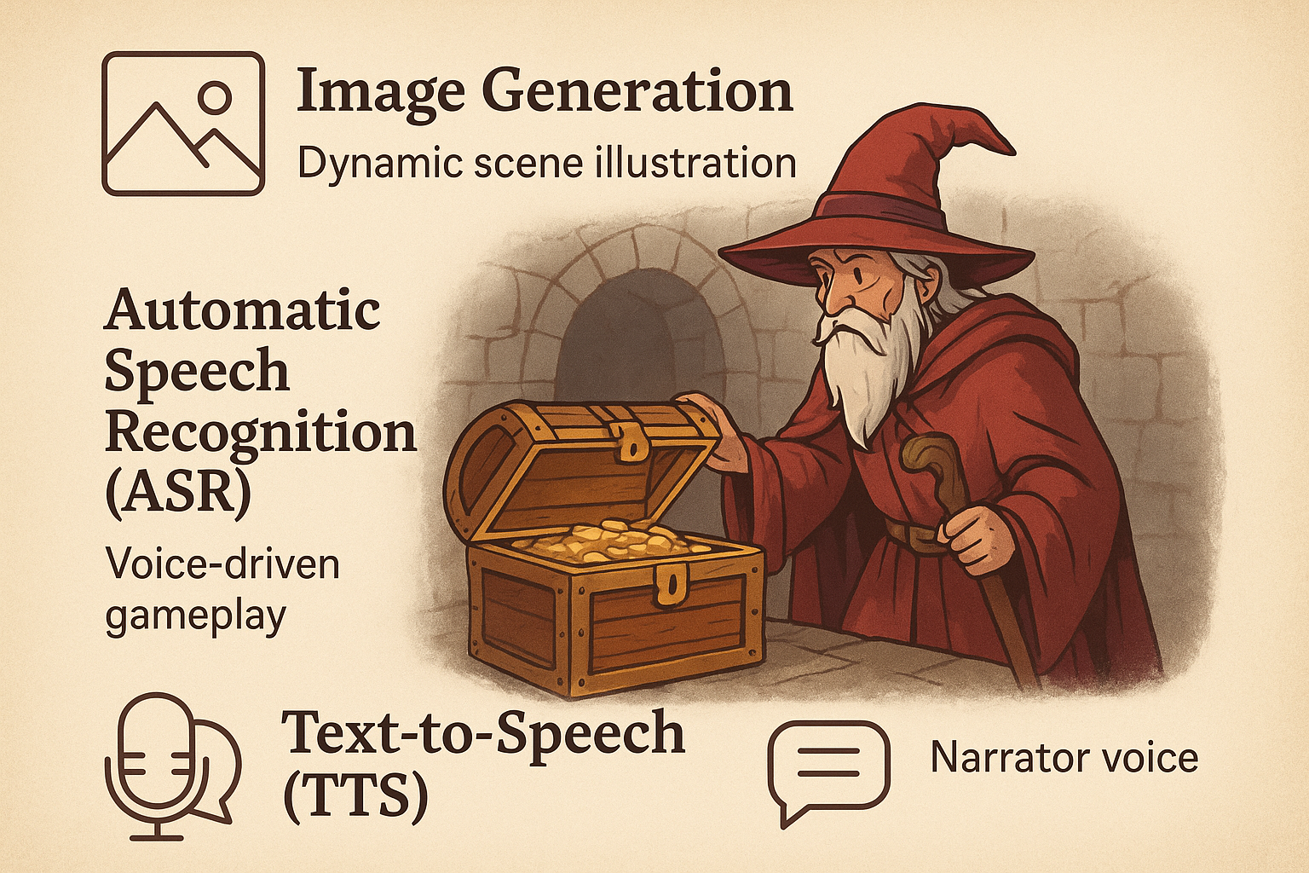
Features in Interactive RPG Gameplay: SZORK

Slide 17

LLM4S Enhanced Tracing
In LLM4S, tracing is like a detailed “black box recorder” for AI agents.
It tracks every step an agent takes from receiving a user’s question, to calling tools, to generating the final answer.
Tracing That Turns AI’s Black Box Into a Glass Box
Key Features:
Records every important event in an AI agent’s lifecycle
Captures user queries, LLM responses, tool calls, and errors
Works across different environments - from local testing to production
Think of it as a “play-by-play replay” of your AI’s decision-making

Slide 18
Tracing & Observability in LLM4S
Tracing systems transform raw LLM executions into structured, visual, and analyzable traces enabling teams to understand, debug, and optimize AI workflows.
LangfuseTracing → Rich Visual Analytics
When to use: Performance tuning, multi-step debugging
Interactive timelines of prompt → response → tool calls
Metrics for latency, token usage, and cost per run
Perfect for deep dives in production scenarios
Console Tracing → Lightweight & Instant
When to use: Local dev, quick iterations
Prints structured trace logs directly to the terminal
Zero setup, minimal overhead
Ideal for debugging logic flow without external tools
NoOp Tracing → Tracing Disabled
When to use: Max performance, production cost savings
No tracing data collected or stored
Minimal CPU/memory impact
Useful for testing performance without observability overhead

Slide 19
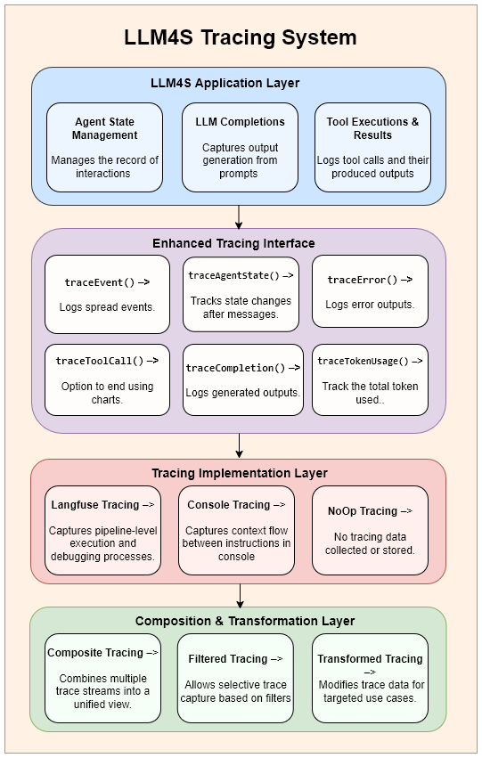
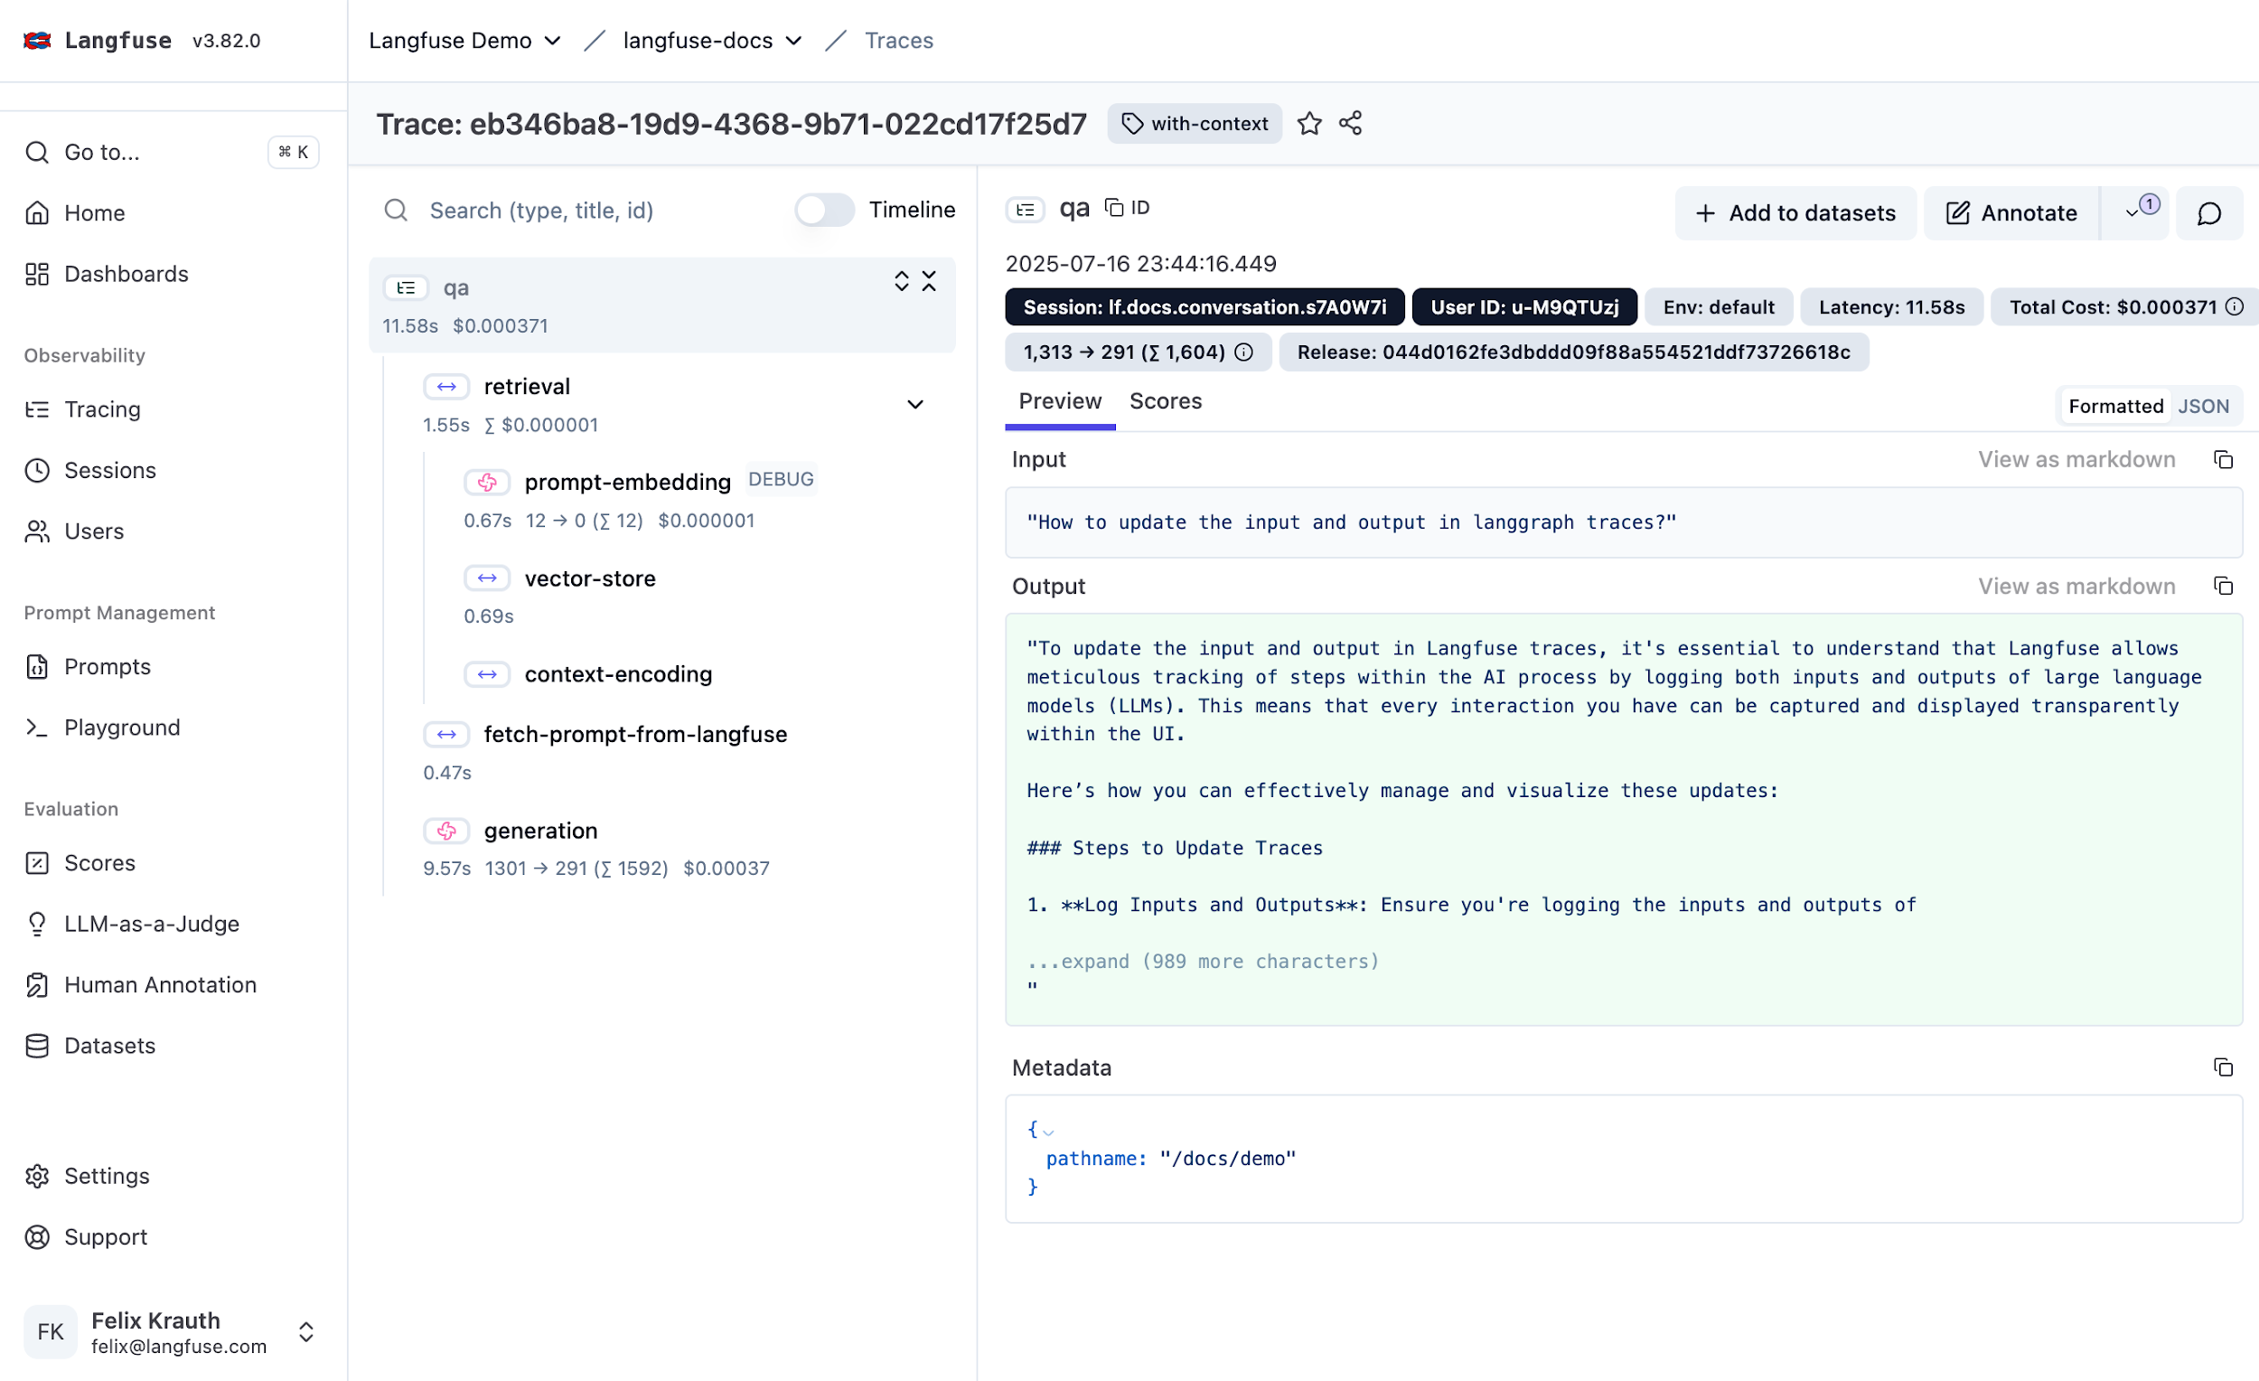
Tracing in Action – Langfuse for LLM4S
Step-by-Step Trace Visualization in Langfuse
Flowchart of LLM4S Tracing
Tracing transforms AI from a black box into a glass box, revealing every step with clarity.

Slide 20
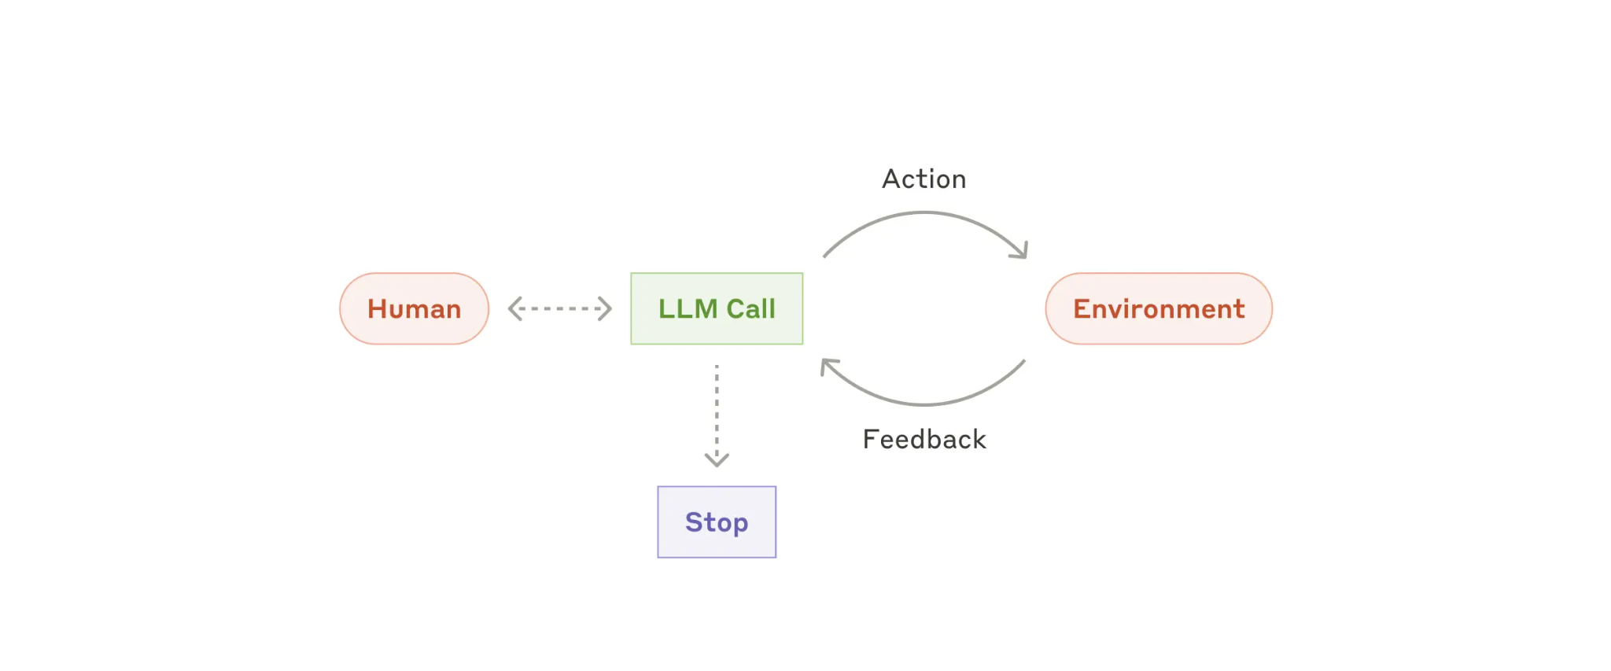
Agents
write code
run tests
run shell commands
Code execution environment
(container)
Code Spec
Agent
Specification
Met
Observe results

Slide 21
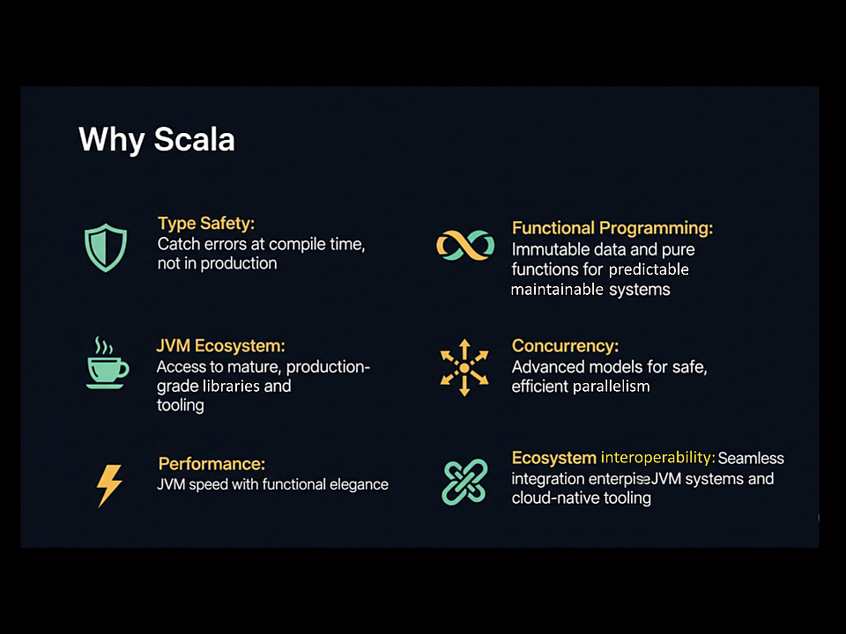
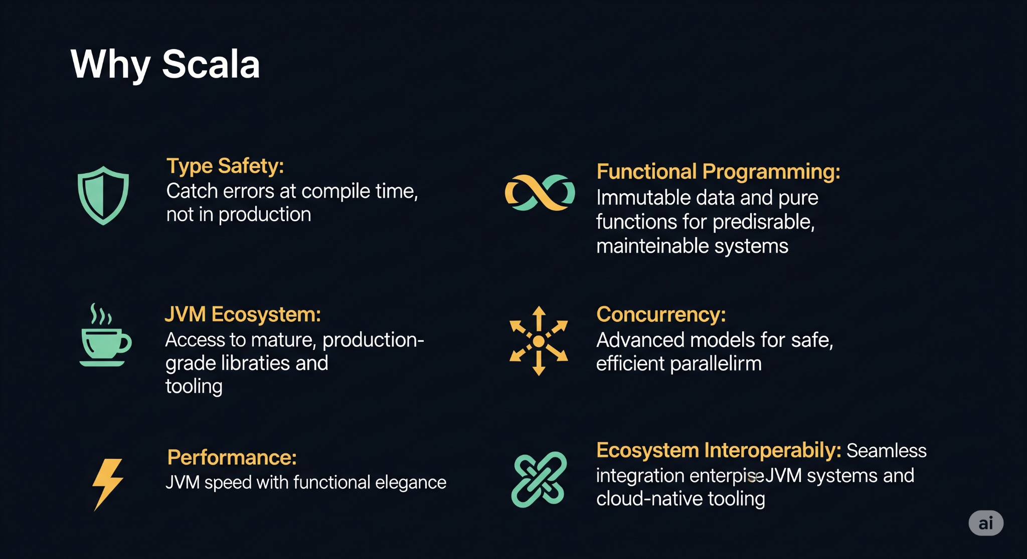



Why Scala for LLM Code generation?
Helps validate code
Helps LLM understand valid parameters
Provides good errors
Provides
accurate search
predictable
maintainable
libraries
parallelism
Great ecosystem
…
interoperability:

Slide 22


Python - Fails at runtime
Result =

Slide 23
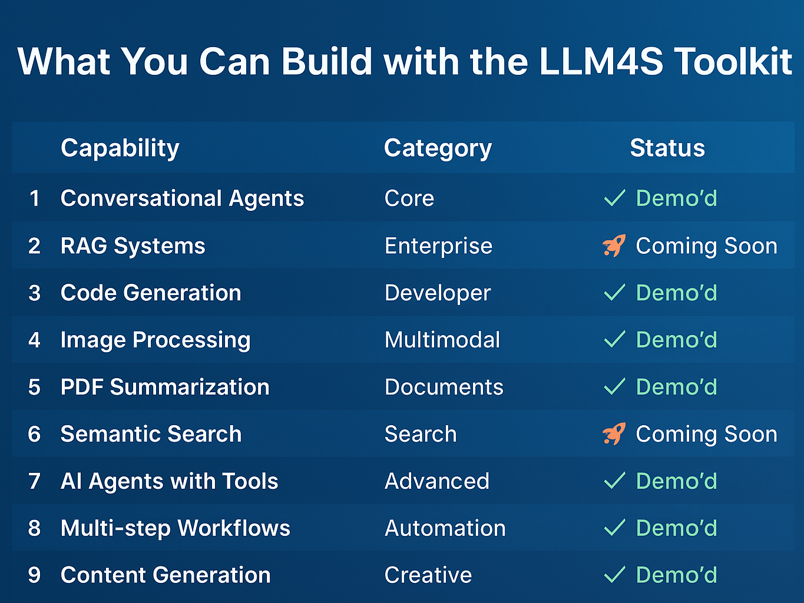
What You Can Build using LLM4S toolkit
Conversational Agents
RAG Systems
Code Generation
Core
Enterprise
Developer
✓ Demo'd
✓ Coming soon
✓ Demo’d
Image Processing
PDF Summarization
Semantic Search
Multimodal
Documents
Search
✓ Demo'd
✓ Demo'd
✓ Coming soon
AI Agents with Tools
Multi-step Workflows
Content Generation
Advanced
Automation
Creative
✓ Demo'd
✓ Demo'd
✓ Demo'd

Slide 24



Ready to Build the Next Gen AI App?
Join Us! 😄
LLM4S GitHub Issues(https://lnkd.in/eXrhwgWY)
Explore the LLM4S project that bridges AI and Scala, fostering innovation in intelligent development
Star us on github 😉

Slide 25
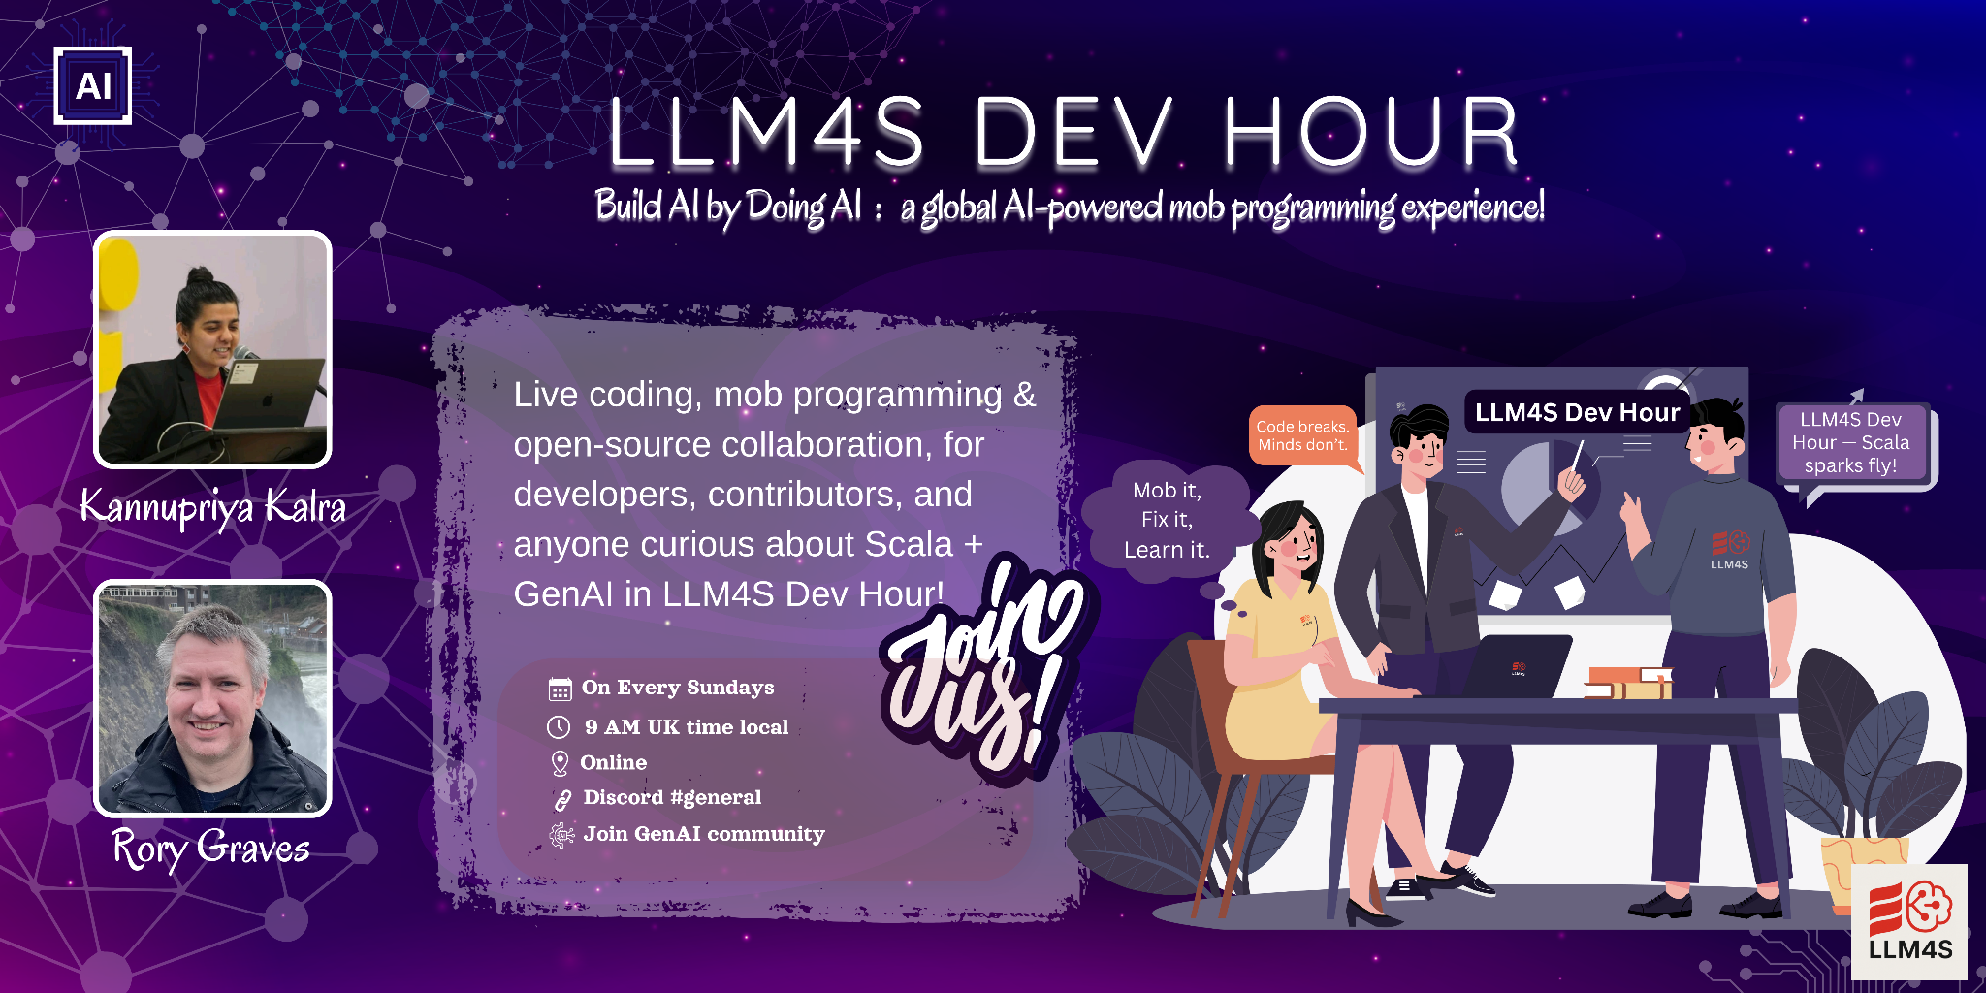

Slide 26



Join the Movement : Build the Cool Stuff
🌍 GenAI community:
Opportunity to learn AI while building AI
We are 100+ members from across globe

Slide 27
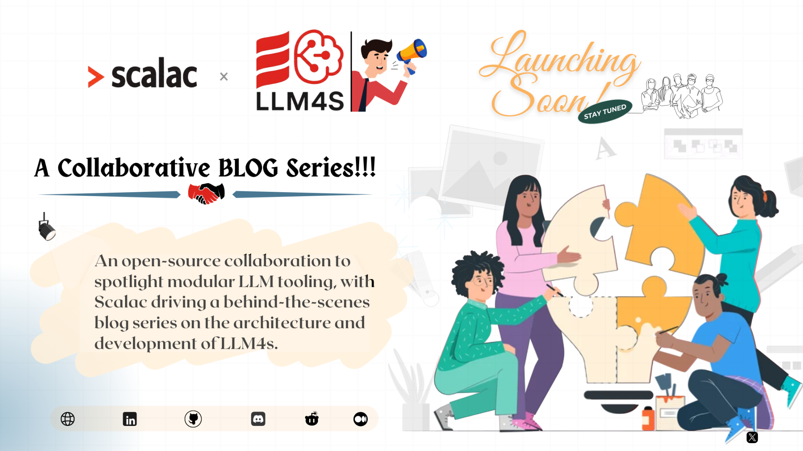

Slide 28




Questions?
Kannupriya Kalra
Rory Graves
kannupriyakalra@gmail.com
@kannupriyakalra_46520
linkedin.com/in/kannupriyakalra
rory.graves@fieldmark.co.uk
@rorybot1
linkedin.com/in/roryjgraves

Slide 29

Don’t forget to star us on Github :)

